Slide 1
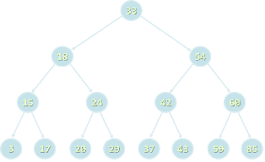

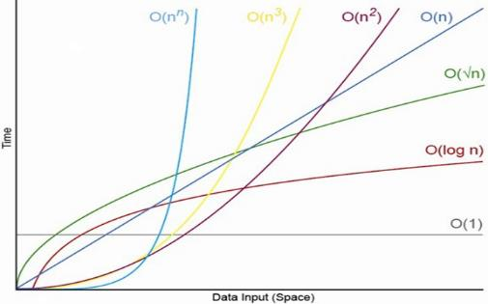
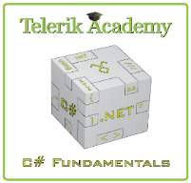
Data Structures, Algorithms and Complexity
Overview of Data Structures and Basic Algorithms. Computational Complexity. Asymptotic Notation
Svetlin Nakov
Technical Trainer
www.nakov.com
Telerik Software Academy
academy.telerik.com

Slide 2

Table of Contents
Data Structures Overview
Linear Structures, Trees, Hash Tables, Others
Algorithms Overview
Sorting and Searching, Combinatorics, Dynamic Programming, Graphs, Others
Algorithms Complexity
Time and Memory Complexity
Mean, Average and Worst Case
Asymptotic Notation O(g)

Slide 3

Data Structures
Introduction

Slide 4
What is a Data Structure?
“In computer science, a data structure is a particular way of storing and organizing data in a computer so that it can be used efficiently.”
-- Wikipedia
Examples of data structures:
Person structure (first name + last name + age)
Array of integers – int[]
List of strings – List<string>
Queue of people – Queue<Person>

Slide 5
Why Are Data Structures So Important?
Data structures and algorithms are the foundation of computer programming
Algorithmic thinking, problem solving and data structures are vital for software engineers
All .NET developers should know when to use T[], LinkedList<T>, List<T>, Stack<T>, Queue<T>, Dictionary<K,T>, HashSet<T>, SortedDictionary<K,T> and SortedSet<T>
Computational complexity is important for algorithm design and efficient programming

Slide 6
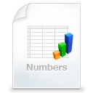
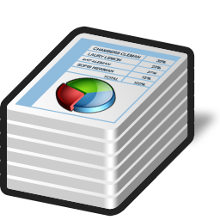

Primitive Types and Collections
Primitive data types
Numbers: int, float, decimal, …
Text data: char, string, …
Simple structures
A group of fields stored together
E.g. DateTime, Point, Rectangle, …
Collections
A set of elements (of the same type)
E.g. array, list, stack, tree, hash-table, …

Slide 7

Abstract Data Types (ADT)
An Abstract Data Type (ADT) is
A data type together with the operations, whose properties are specified independently of any particular implementation
ADT are set of definitions of operations
Like the interfaces in C#
ADT can have multiple different implementations
Different implementations can have different efficiency, inner logic and resource needs
abstract data

Slide 8

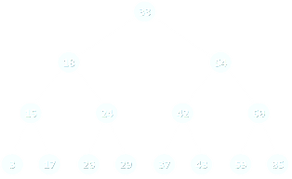

Basic Data Structures
Linear structures
Lists: fixed size and variable size
Stacks: LIFO (Last In First Out) structure
Queues: FIFO (First In First Out) structure
Trees and tree-like structures
Binary, ordered search trees, balanced, etc.
Dictionaries (maps)
Contain pairs (key, value)
Hash tables: use hash functions to search/insert

Slide 9


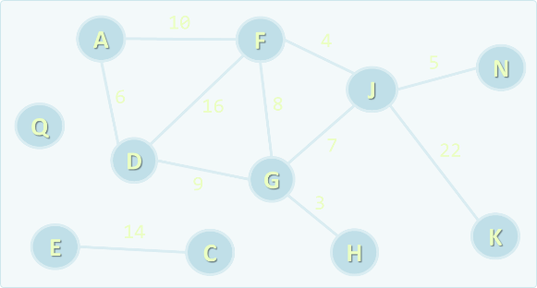
Basic Data Structures (2)
Sets and bags
Set – collection of unique elements
Bag – collection of non-unique elements
Ordered sets, bags and dictionaries
Priority queues / heaps
Special tree structures
Suffix tree, interval tree, index tree, trie
Graphs
Directed / undirected, weighted / un-weighted, connected/ non-connected, …

Slide 10



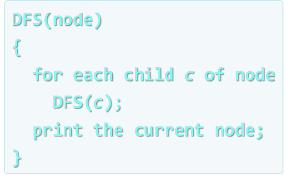
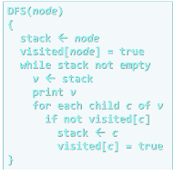
Algorithms
Introduction

Slide 11
What is an Algorithm?
“In mathematics and computer science, an algorithm is a step-by-step procedure for calculations. An algorithm is an effective method expressed as a finite list of well-defined instructions for calculating a function.”
-- Wikipedia
The term "algorithm" comes from the
Derived from Muḥammad Al-Khwārizmī', a Persian mathematician and astronomer
An algorithm for solving quadratic equations

Slide 12
Algorithms in Computer Science
Algorithms are fundamental in programming
Imperative (traditional) programming means to describe in formal steps how to do something
Algorithm == sequence of operations (steps)
Can include branches (conditional blocks) and repeated logic (loops)
Algorithmic thinking (mathematical thinking, logical thinking, engineering thinking)
Ability to decompose the problems into formal sequences of steps (algorithms)

Slide 13
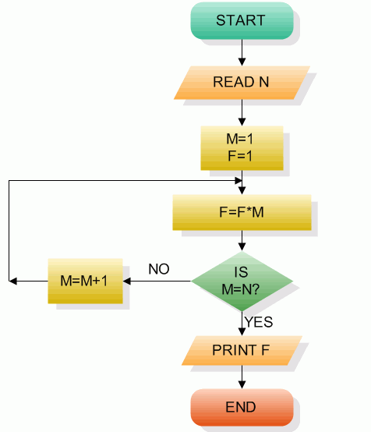
Pseudocode and Flowcharts
Algorithms can be expressed in pseudocode, through flowcharts or program code
BFS(node)
{
queue ← node
while queue not empty
v ← queue
print v
for each child c of v
queue ← c
}
Example of pseudocode
Example of flowchart

Slide 14


Algorithms in Programming
Sorting and searching
Dynamic programming
Graph algorithms
DFS and BFS traversals
Combinatorial algorithms
Recursive algorithms
Other algorithms
Greedy algorithms, computational geometry, randomized algorithms, genetic algorithms

Slide 15

Algorithm Complexity
Asymtotic Notation

Slide 16
Algorithm Analysis
Why we should analyze algorithms?
Predict the resources the algorithm requires
Computational time (CPU consumption)
Memory space (RAM consumption)
Communication bandwidth consumption
The running time of an algorithm is:
The total number of primitive operations executed (machine independent steps)
Also known as algorithm complexity

Slide 17
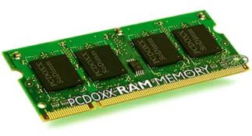
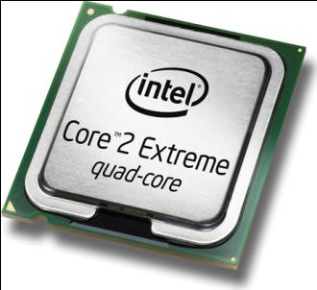

Algorithmic Complexity
What to measure?
CPU Time
Memory
Number of steps
Number of particular operations
Number of disk operations
Number of network packets
Asymptotic complexity

Slide 18
Time Complexity
Worst-case
An upper bound on the running time for any input of given size
Average-case
Assume all inputs of a given size are equally likely
Best-case
The lower bound on the running time (the optimal case)

Slide 19

Time Complexity – Example
Sequential search in a list of size n
Worst-case:
n comparisons
Best-case:
1 comparison
Average-case:
n/2 comparisons
The algorithm runs in linear time
Linear number of operations
… | … | … | … | … | … | …
n

Slide 20
Algorithms Complexity
Algorithm complexity is a rough estimation of the number of steps performed by given computation depending on the size of the input data
Measured through asymptotic notation
O(g) where g is a function of the input data size
Examples:
Linear complexity O(n) – all elements are processed once (or constant number of times)
Quadratic complexity O(n²) – each of the elements is processed n times

Slide 21
Asymptotic Notation: Definition
Asymptotic upper bound
O-notation (Big O notation)
For given function g(n), we denote by O(g(n)) the set of functions that are different than g(n) by a constant
Examples:
3 * n² + n/2 + 12 ∈ O(n²)
4*n*log₂(3*n+1) + 2*n-1 ∈ O(n * log n)
O(g(n)) = {f(n): there exist positive constants c and n₀ such that f(n) <= c*g(n) for all n >= n₀}

Slide 22
Typical Complexities
Complexity | Notation | Description
constant | O(1) | Constant number of operations, not depending on the input data size, e.g. n = 1 000 000 → 1-2 operations
logarithmic | O(log n) | Number of operations propor-tional of log₂(n) where n is the size of the input data, e.g. n = 1 000 000 000 → 30 operations
linear | O(n) | Number of operations proportional to the input data size, e.g. n = 10 000 → 5 000 operations

Slide 23
Typical Complexities (2)
Complexity | Notation | Description
quadratic | O(n²) | Number of operations proportional to the square of the size of the input data, e.g. n = 500 → 250 000 operations
cubic | O(n³) | Number of operations propor-tional to the cube of the size of the input data, e.g. n = 200 → 8 000 000 operations
exponential | O(2^{n}), O(k^{n}), O(n!) | Exponential number of operations, fast growing, e.g. n = 20 → 1 048 576 operations

Slide 24
Time Complexity and Speed
Complexity | 10 | 20 | 50 | 100 | 1 000 | 10 000 | 100 000
O(1) | < 1 s | < 1 s | < 1 s | < 1 s | < 1 s | < 1 s | < 1 s
O(log(n)) | < 1 s | < 1 s | < 1 s | < 1 s | < 1 s | < 1 s | < 1 s
O(n) | < 1 s | < 1 s | < 1 s | < 1 s | < 1 s | < 1 s | < 1 s
O(n*log(n)) | < 1 s | < 1 s | < 1 s | < 1 s | < 1 s | < 1 s | < 1 s
O(n²) | < 1 s | < 1 s | < 1 s | < 1 s | < 1 s | 2 s | 3-4 min
O(n³) | < 1 s | < 1 s | < 1 s | < 1 s | 20 s | 5 hours | 231 days
O(2^{n}) | < 1 s | < 1 s | 260 days | hangs | hangs | hangs | hangs
O(n!) | < 1 s | hangs | hangs | hangs | hangs | hangs | hangs
O(n^{n}) | 3-4 min | hangs | hangs | hangs | hangs | hangs | hangs

Slide 25
Time and Memory Complexity
Complexity can be expressed as formula on multiple variables, e.g.
Algorithm filling a matrix of size n * m with the natural numbers 1, 2, … will run in O(n*m)
A traversal of graph with n vertices and m edges will run in O(n + m)
Memory consumption should also be considered, for example:
Running time O(n) & memory requirement O(n²)
n = 50 000 → OutOfMemoryException

Slide 26
The Hidden Constant
Sometimes a linear algorithm could be slower than quadratic algorithm
The hidden constant could be significant
Example:
Algorithm A makes: 100*n steps → O(n)
Algorithm B makes: n*n/2 steps → O(n²)
For n < 200 the algorithm B is faster
Real-world example:
Insertion sort is faster than quicksort for n < 9

Slide 27
Polynomial Algorithms
A polynomial-time algorithm is one whose worst-case time complexity is bounded above by a polynomial function of its input size
Examples:
Polynomial-time: log n, 2n, 3n³ + 4n, 2 * n log n
Non polynomial-time : 2^{n}, 3^{n}, n^{k}, n!
Non-polynomial algorithms hang for large input data sets
W(n) ∈ O(p(n))

Slide 28
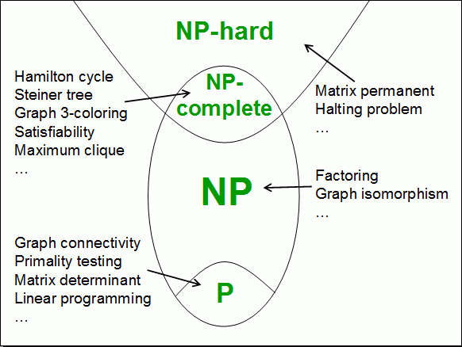
Computational Classes
Computational complexity theory divides the computational problems into several classes:

Slide 29


Analyzing Complexity of Algorithms
Examples

Slide 30
Complexity Examples
int FindMaxElement(int[] array)
{
int max = array[0];
for (int i=0; i<array.length; i++)
{
if (array[i] > max)
{
max = array[i];
}
}
return max;
}
Runs in O(n) where n is the size of the array
The number of elementary steps is ~ n

Slide 31
Complexity Examples (2)
long FindInversions(int[] array)
{
long inversions = 0;
for (int i=0; i<array.Length; i++)
for (int j = i+1; j<array.Length; i++)
if (array[i] > array[j])
inversions++;
return inversions;
}
Runs in O(n²) where n is the size of the array
The number of elementary steps is ~ n*(n+1) / 2

Slide 32
Complexity Examples (3)
decimal Sum3(int n)
{
decimal sum = 0;
for (int a=0; a<n; a++)
for (int b=0; b<n; b++)
for (int c=0; c<n; c++)
sum += a*b*c;
return sum;
}
Runs in cubic time O(n³)
The number of elementary steps is ~ n³

Slide 33
Complexity Examples (4)
long SumMN(int n, int m)
{
long sum = 0;
for (int x=0; x<n; x++)
for (int y=0; y<m; y++)
sum += x*y;
return sum;
}
Runs in quadratic time O(n*m)
The number of elementary steps is ~ n*m

Slide 34
Complexity Examples (5)
long SumMN(int n, int m)
{
long sum = 0;
for (int x=0; x<n; x++)
for (int y=0; y<m; y++)
if (x==y)
for (int i=0; i<n; i++)
sum += i*x*y;
return sum;
}
Runs in quadratic time O(n*m)
The number of elementary steps is ~ n*m + min(m,n)*n

Slide 35
Complexity Examples (6)
decimal Calculation(int n)
{
decimal result = 0;
for (int i = 0; i < (1<<n); i++)
result += i;
return result;
}
Runs in exponential time O(2^{n})
The number of elementary steps is ~ 2^{n}

Slide 36
Complexity Examples (7)
decimal Factorial(int n)
{
if (n==0)
return 1;
else
return n * Factorial(n-1);
}
Runs in linear time O(n)
The number of elementary steps is ~ n

Slide 37
Complexity Examples (8)
decimal Fibonacci(int n)
{
if (n == 0)
return 1;
else if (n == 1)
return 1;
else
return Fibonacci(n-1) + Fibonacci(n-2);
}
Runs in exponential time O(2^{n})
The number of elementary steps is ~ Fib(n+1) where Fib(k) is the k-th Fibonacci's number

Slide 38
Summary
Data structures organize data for efficient use
ADT describe a set of operations
Collections hold a group of elements
Algorithms are sequences of steps for performing or calculating something
Algorithm complexity is rough estimation of the number of steps performed by given computation
Complexity can be logarithmic, linear, n log n, square, cubic, exponential, etc.
Allows to estimating the speed of given code before its execution

Slide 39

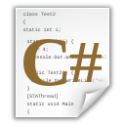
Data Structures, Algorithms and Complexity
http://academy.telerik.com

Slide 40
Exercises
What is the expected running time of the following C# code? Explain why. Assume the array's size is n.
long Compute(int[] arr)
{
long count = 0;
for (int i=0; i<arr.Length; i++)
{
int start = 0, end = arr.Length-1;
while (start < end)
if (arr[start] < arr[end])
{ start++; count++; }
else
end--;
}
return count;
}

Slide 41
Exercises (2)
What is the expected running time of the following C# code? Explain why.
Assume the input matrix has size of n * m.
long CalcCount(int[,] matrix)
{
long count = 0;
for (int row=0; row<matrix.GetLength(0); row++)
if (matrix[row, 0] % 2 == 0)
for (int col=0; col<matrix.GetLength(1); col++)
if (matrix[row,col] > 0)
count++;
return count;
}

Slide 42
Exercises (3)
* What is the expected running time of the following C# code? Explain why.
Assume the input matrix has size of n * m.
long CalcSum(int[,] matrix, int row)
{
long sum = 0;
for (int col = 0; col < matrix.GetLength(0); col++)
sum += matrix[row, col];
if (row + 1 < matrix.GetLength(1))
sum += CalcSum(matrix, row + 1);
return sum;
}
Console.WriteLine(CalcSum(matrix, 0));

Slide 43
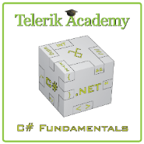



Free Trainings @ Telerik Academy
C# Programming @ Telerik Academy
csharpfundamentals.telerik.com
Telerik Software Academy
academy.telerik.com
Telerik Academy @ Facebook
facebook.com/TelerikAcademy
Telerik Software Academy Forums
forums.academy.telerik.com

